Slide 1
Sentiment Analysis on Product Reviews Using Machine Learning Techniques
Realised by:
Achargui Afkir Aymane
Tribak Mohammed
Yahiaoui Anass
Zaid Ilyass

Slide 2
Abstract: Sentiment Analysis and Opinion Mining are crucial for analyzing text data from diverse sources like social media platforms and e-commerce websites. They provide valuable insights into customer feedback, allowing businesses to enhance their strategies. This study focuses on a dataset from Amazon, containing reviews of various electronic products. After preprocessing the data, machine learning algorithms were employed to classify the reviews as positive or negative. The results demonstrate the effectiveness of machine learning in accurately categorizing product reviews. This study confirms that Machine Learning Techniques deliver excellent results in classifying product reviews. Decision Tree achieved 62.06% accuracy, while K-NN achieved a remarkable accuracy of 34,48%, specifically for laptop reviews. These findings emphasize the effectiveness of Machine Learning Techniques in accurately categorizing product reviews.

Slide 3

Table of contents
01
02
03
04
Introduction
The importance of sentiment analysis for business
An overview of Amazon
Machine Learning techniques for sentiment analysis
05
Proposed method

Slide 4
01
Introduction:

Slide 5
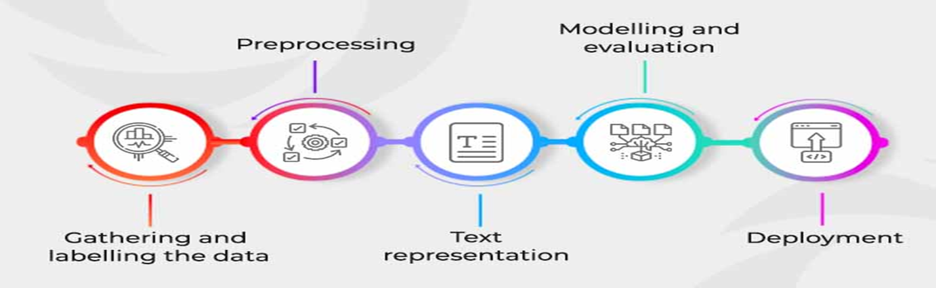
Sentiment analysis, also known as opinion mining, is a computational technique used to determine the sentiment or subjective information expressed in text documents. It involves analyzing the text to identify and classify the underlying sentiment as positive, negative, or neutral.
Machine learning techniques are commonly employed for sentiment analysis due to their ability to automatically learn patterns and extract features from large volumes of textual data. The process usually involves the following steps:

Slide 6
02
The importance of sentiment Analysis for business:

Slide 7
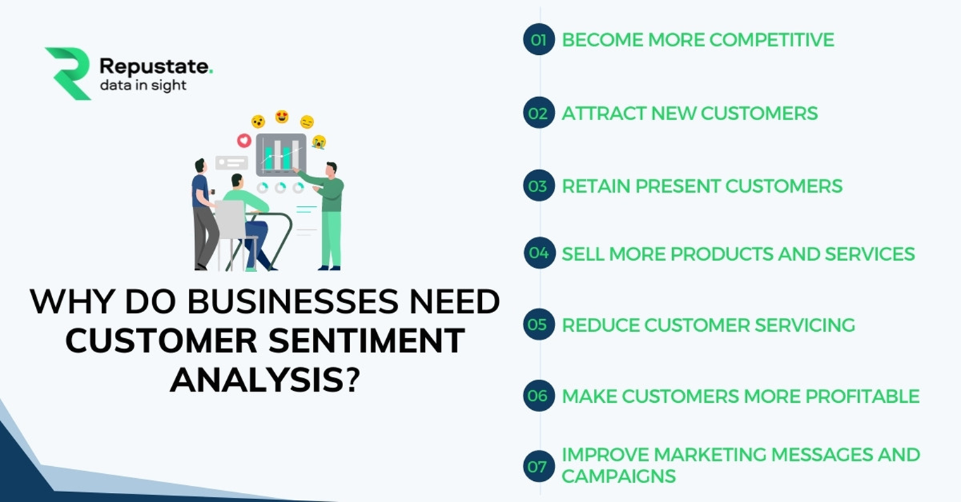
The importance of sentiment Analysis for business:
Sentiment analysis is a valuable tool in business as it allows companies to understand and analyze the opinions, attitudes, and emotions expressed by their customers, employees, and the general public.
The following figure shows the reasons why the the reason why sentiment analysis is important for businesses:

Slide 8
03
An overview of Amazon

Slide 9
Amazon is one of the world's largest online marketplaces, offering a vast range of products from various sellers. One of the key features that sets Amazon apart is its robust review system, where customers can leave feedback and ratings on the products they purchase. These product reviews play a crucial role in shaping the overall shopping experience on Amazon.

Slide 10
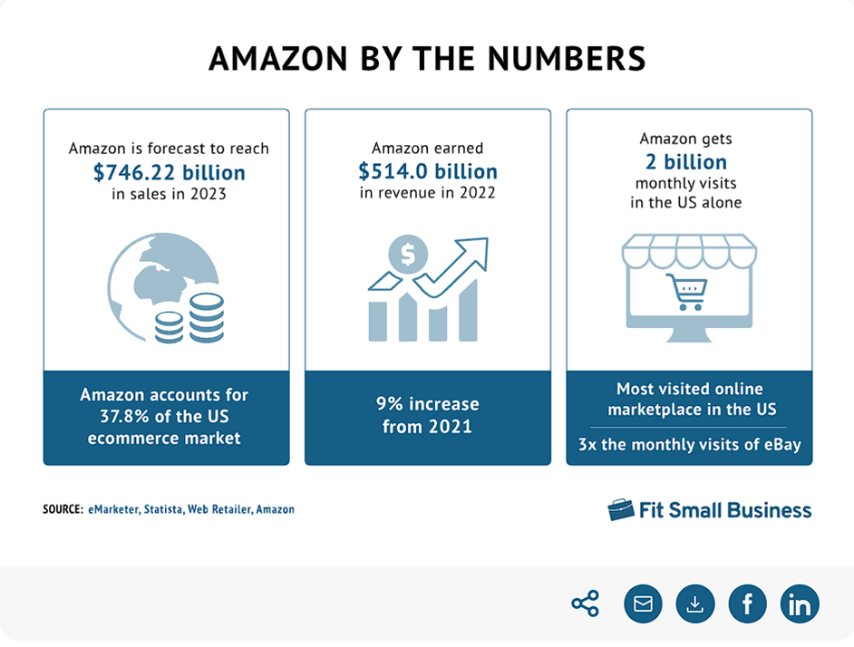

Slide 11
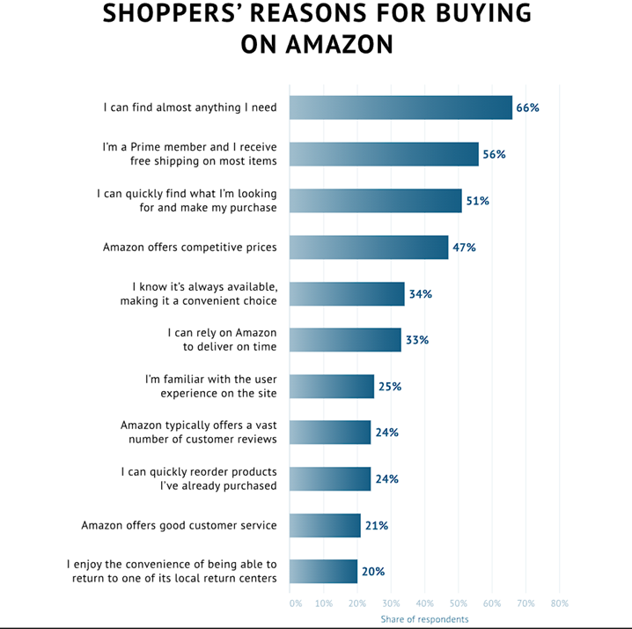

Slide 12
04
Machine learning techniques for sentiment analysis:

Slide 13
Machine learning techniques for sentiment analysis:
Machine learning plays a significant role in sentiment analysis, which is the process of determining the sentiment or emotional tone expressed in a piece of text. Sentiment analysis is widely used in various applications, including social media monitoring, customer feedback analysis, brand reputation management, and market research. In this example, the project was based on 2 specific models which are k-NN and decision tree model:

Slide 14
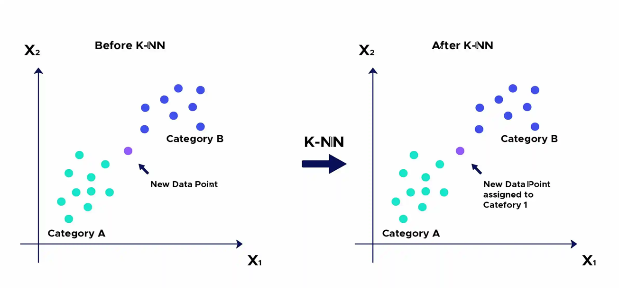
A K-NN (k nearest neighbors) model is a supervised learning algorithm used for classification and regression. It is based on the principle that similar data points tend to be close to each other in the feature space.

Slide 15
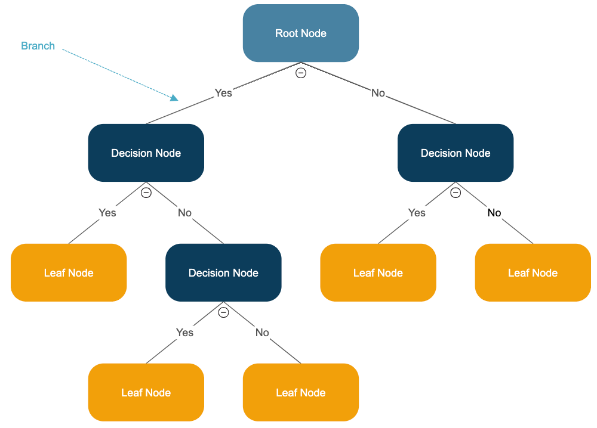
The decision tree model is a supervised learning algorithm used for classification and regression.classification and regression. It creates a model by forming a tree in which each noderepresents a test function on a feature, and each leaf represents an output label

Slide 16
05
Proposed Method

Slide 17
In the proposed method, the following preprocessing tasks were performed to classify sentiment analysis from reviews:
Data collection and preprocessing:
Data collection is an essential step in the development of machine learning models.machine learning models, as the quality and relevance of the data collected have a directhave a direct impact on model performance and accuracy. The data must berepresentative of the task the model is to perform, and must cover a variety of possible to ensure efficient generalization.
Data pre-processing in machine learning is an essential step in preparing raw data for use in model training. It includes several actions such as cleaning the data by removing outliers and duplicates, transforming the data by normalizing or encoding it, selecting the most relevant features, reducing dimensionality where necessary, and dividing the data into training, validation and test sets. This process improves data quality and reliability, leading to better results when training machine learning models.

Slide 18
Web scrapping :
Web scraping refers to the automated extraction of data from websites. It involves using software or scripts to access and collect information from web pages by simulating human interaction with the website.
We choosed to work with web automation website to scrap the dataset from Amazon for six products which are : Camera- laptops – Mobile Phones- Tablets – TVs – Video surveillance.
Web automation can be considered a tool or technique used in web scraping, but they are not the same thing. Web automation refers to the process of automating tasks on the web by simulating user interactions. It involves using software or scripts to interact with web pages, fill out forms, click buttons, navigate through pages, and extract or manipulate data.

Slide 19

The screens below show how WebAutomation helps to scrap dataset:

Slide 20
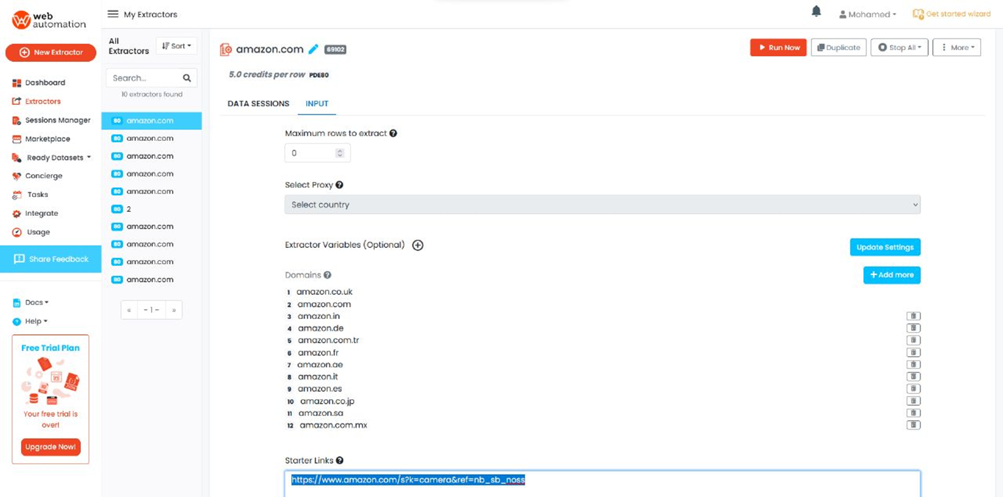
After selecting amazon, we validate the link of the product just like the screenshot shows:

Slide 21
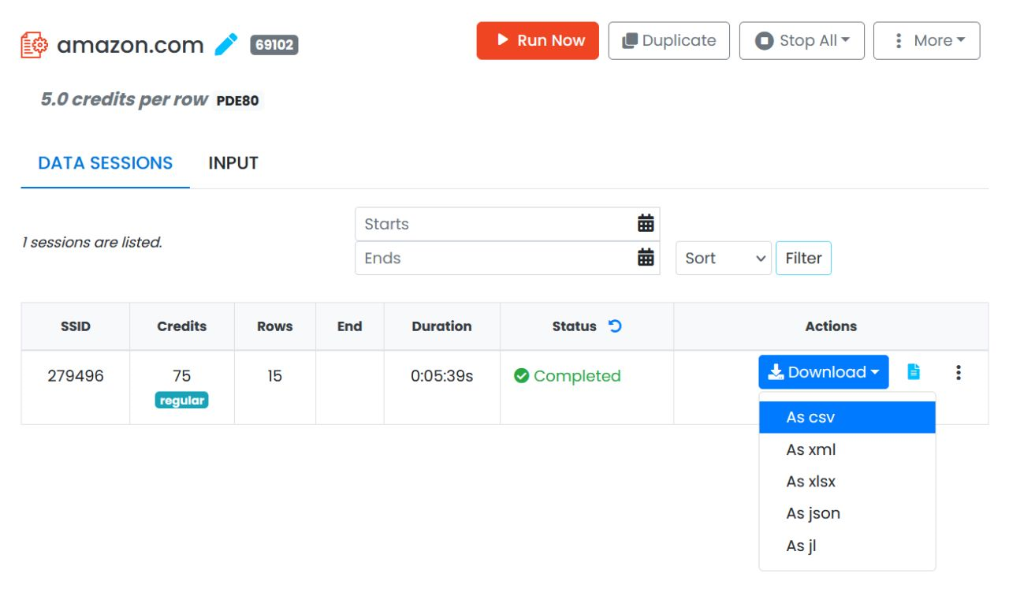
When the scrapping is finally done, the website gives us the choice of the format of the dataset. In our case, we worked on dataset.csv :

Slide 22
Features Extraction :
Data characteristics, also known as "features", are the variables used by machine learning algorithms to make predictions. The choice of features is essential, as it can have a significant impact on model performance. Careful selection of features relevant to the specific problem is important, as it enables a better understanding of the relationships between variables and improves the model's ability to generalize and produce accurate predictions. In short, choosing the right features contributes to the efficiency and accuracy of machine learning models.

Slide 23
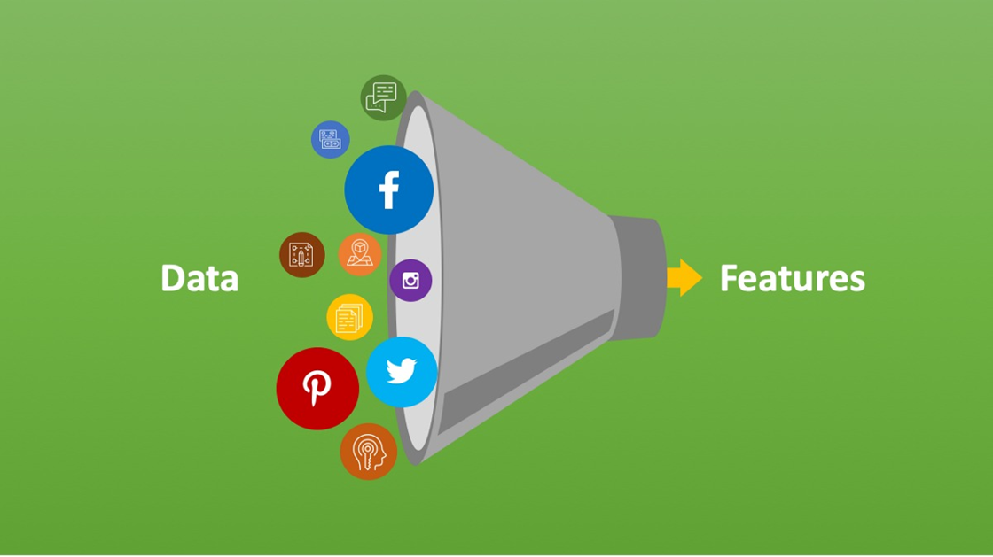
During this stage, the training data is provided to the machine learning model. The algorithm then adjusts the model's internal parameters to minimize the discrepancy between the model's predictions and the actual training data.

Slide 24
Model training and evaluation :
Once you are satisfied with the model's performance, you can proceed to a more thorough evaluation by testing it with new data.This allows you to measure the model's actual performance and determine whether it meets the requirements of the problem, by evaluating its ability to generalize and produce accurate results.requirements of the problem, by assessing its ability to generalize and produce accurate results on unknown data.

Slide 25
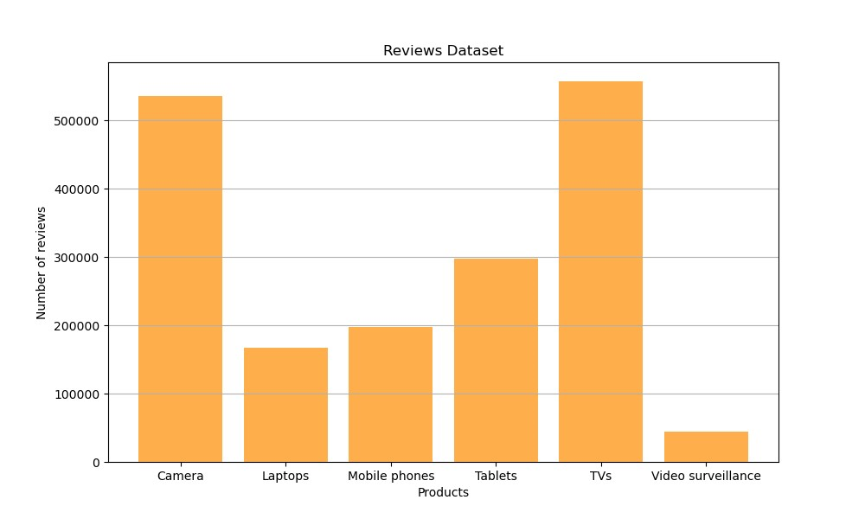
Results and analysis
In the end, we conclude our project by analysing these graphics :
Reviews Dataser graphic:

Slide 26
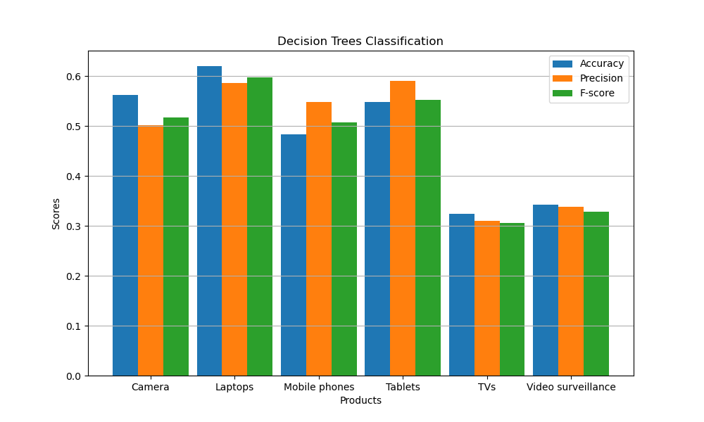
The experimental result of Decision Tree model:

Slide 27
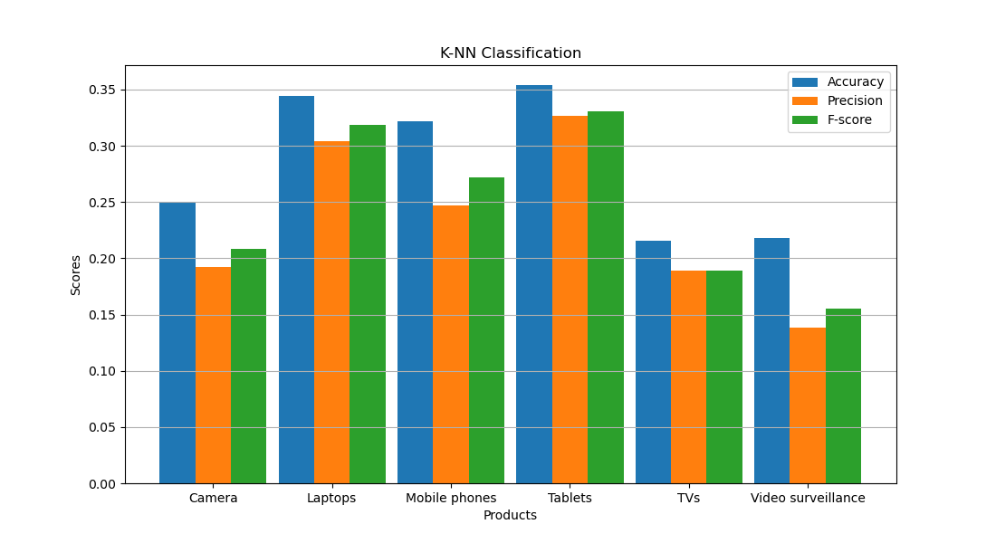
The experimental result of k-NN model:

Slide 28
Conclusion
In the digital era, sentiment analysis and opinion mining are crucial for informed decision-making across industries. This study focused on analyzing product reviews from Amazon, encompassing cameras, laptops, mobile phones, tablets, TVs, and video surveillance devices. By employing a lexicon-based approach and utilizing machine learning techniques such as k-NN and Decision Trees, sentiment analysis was performed on the reviews. The Decision Tree classifier achieved 62,06% accuracy for laptop reviews, while the k-NN classifier achieved an impressive accuracy of 34,48%. Future research can explore aspect-level sentiment analysis to gain deeper insights into specific aspects like laptop quality, CPU performance, screen resolution, size, and battery life. Aspect-level analysis offers a granular approach that holds promise for enhancing sentiment analysis results.

Slide 29
References:
"Aspect and Sentiment Unification Model for Online Review Analysis" Authors: Bing Liu, Minqing Hu, Junsheng Cheng Published: 2005 Source: Proceedings of the 2005 ACM SIGIR International Conference on Research and Development in Information Retrieval
"Mining and Summarizing Customer Reviews" Authors: Minqing Hu, Bing Liu Published: 2004 Source: Proceedings of the ACM SIGKDD International Conference on Knowledge Discovery and Data Mining
"Opinion Observer: Analyzing and Comparing Opinions on the Web" Authors: Bing Liu, Minqing Hu, Junsheng Cheng Published: 2005 Source: Proceedings of the 14th International World Wide Web Conference

